Slide 1
Redgate PowerPoint template
Any questions or problems with this PowerPoint template please email Brand@red-gate.com

Slide 2

Redgate PowerPoint template
Tip 1 - avoid putting any content in the top right-hand corner, this is often where the presenter appears in zoom recordings.
Tip 2 - The correct fonts don't always display correctly even though they're embedded in the PowerPoint file. So the fonts reliably display correctly download and install the fonts onto your computer. You can find the fonts on the typography page.

Slide 3
Contents
Setting this template as your default
Page layouts
Logos and icons
Compliant Database DevOps diagrams
Table and charts
4
6
21
27
39

Slide 4
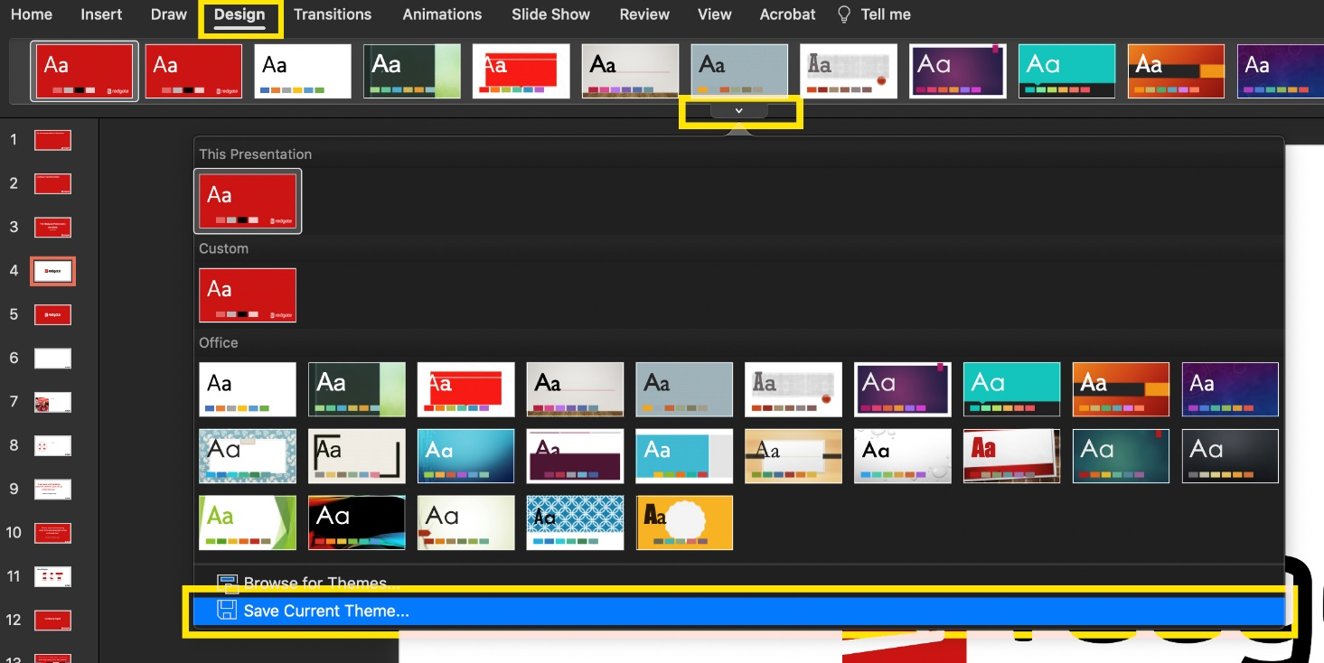
Set this template as your default
Go to Design > Themes and choose “Save Current theme”
Name the theme Redgate theme v2.thmx then save it
Go back to Design > Themes > Custom

Slide 5
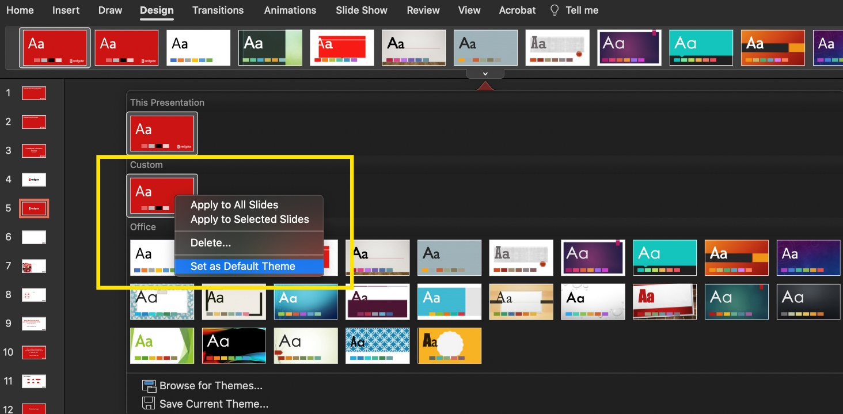
Set this template as your default
Right click the theme you just saved and choose “Set as Default Theme”
Open a blank presentation in PowerPoint, you’ll see the default Redgate template

Slide 6
Page layout examples

Slide 9
This is the title of this presentation
Name goes here

Slide 10
Title of a page
First bullet point
Another one
This is the third point
Forth point
Is this one too many?

Slide 11
Standard slide layout
With a title and a space for content

Slide 12

Slide with an image
And space for content

Slide 13

Slide with an image on the left
And space for content

Slide 14

Slide with an image
And space for content

Slide 15
Three images
Image 1
Image 2
Image 3

Slide 16

Slide with space for a graphic or image
And some points
Can go here

Slide 17
“A quote from someone great can go right here.”
Person or Company Logo
Notes:
Quote in red background

Slide 18
A different section breaker slide here

Slide 19
A subtle section breaker slide
With a subtitle

Slide 20






About Redgate
374
21
202,000
Redgaters
years young
customers
91%
4m
713
of the Fortune 100 use our tools
website visits per quarter
product releases so far this year

Slide 21
Logos and icons

Slide 25


Icons
Cluster
Server
Instance
Database
Database image
Database clone
Database file
Availability group
Schema
Table
Column
User
Team
Alert
Date
Download
Comment
Metrics
Merge branch
Branch
Document
Copy
Warning
Info
Cog (automation)
Backup
Folder
Elastic pool
Foreign key (FK)
Primary key (PK)
Azure database
Azure

Slide 26






















Icons
Arrow
Cross circle
Email
Filter
Edit
External link
Globe
Question mark circle
History
Plus circle
Search
Refresh
Save
Tick circle
Wrench
Visible
Hidden
Lock
Blocked
Target
Script
Lightbulb
Database DevOps solution areas
Developer
DBA
Standardize
Automate
Protect
Monitor

Slide 27
Compliant Database DevOps diagrams

Slide 28
Standardize
team-based development
Automate
database deployments
Protect
and preserve data
Monitor
performance & availability

Slide 29
Standardize
team-based development

Slide 30
Automate
database deployments

Slide 31
Monitor
performance & availability

Slide 32
Protect
and preserve data

Slide 33
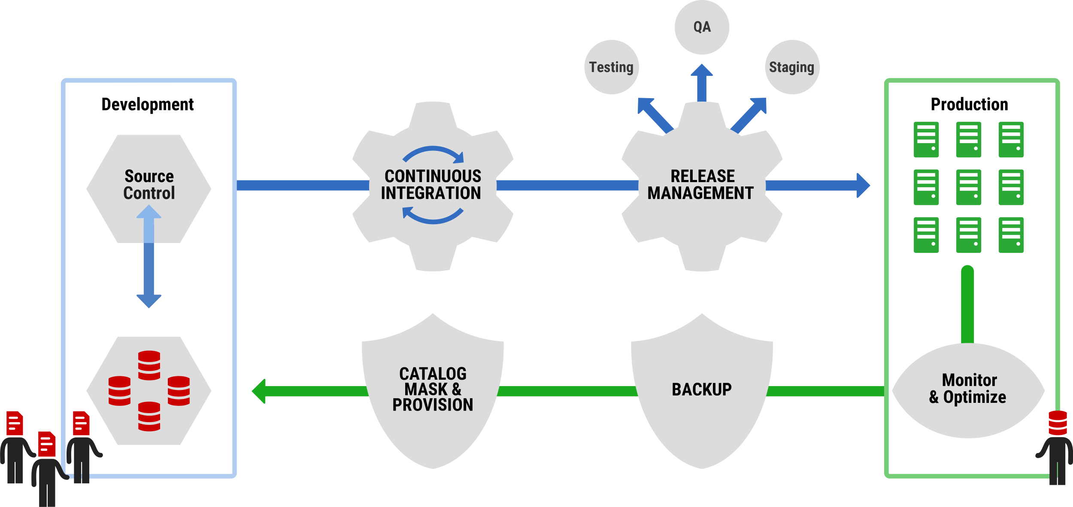
What does Compliant Database DevOps look like?

Slide 34
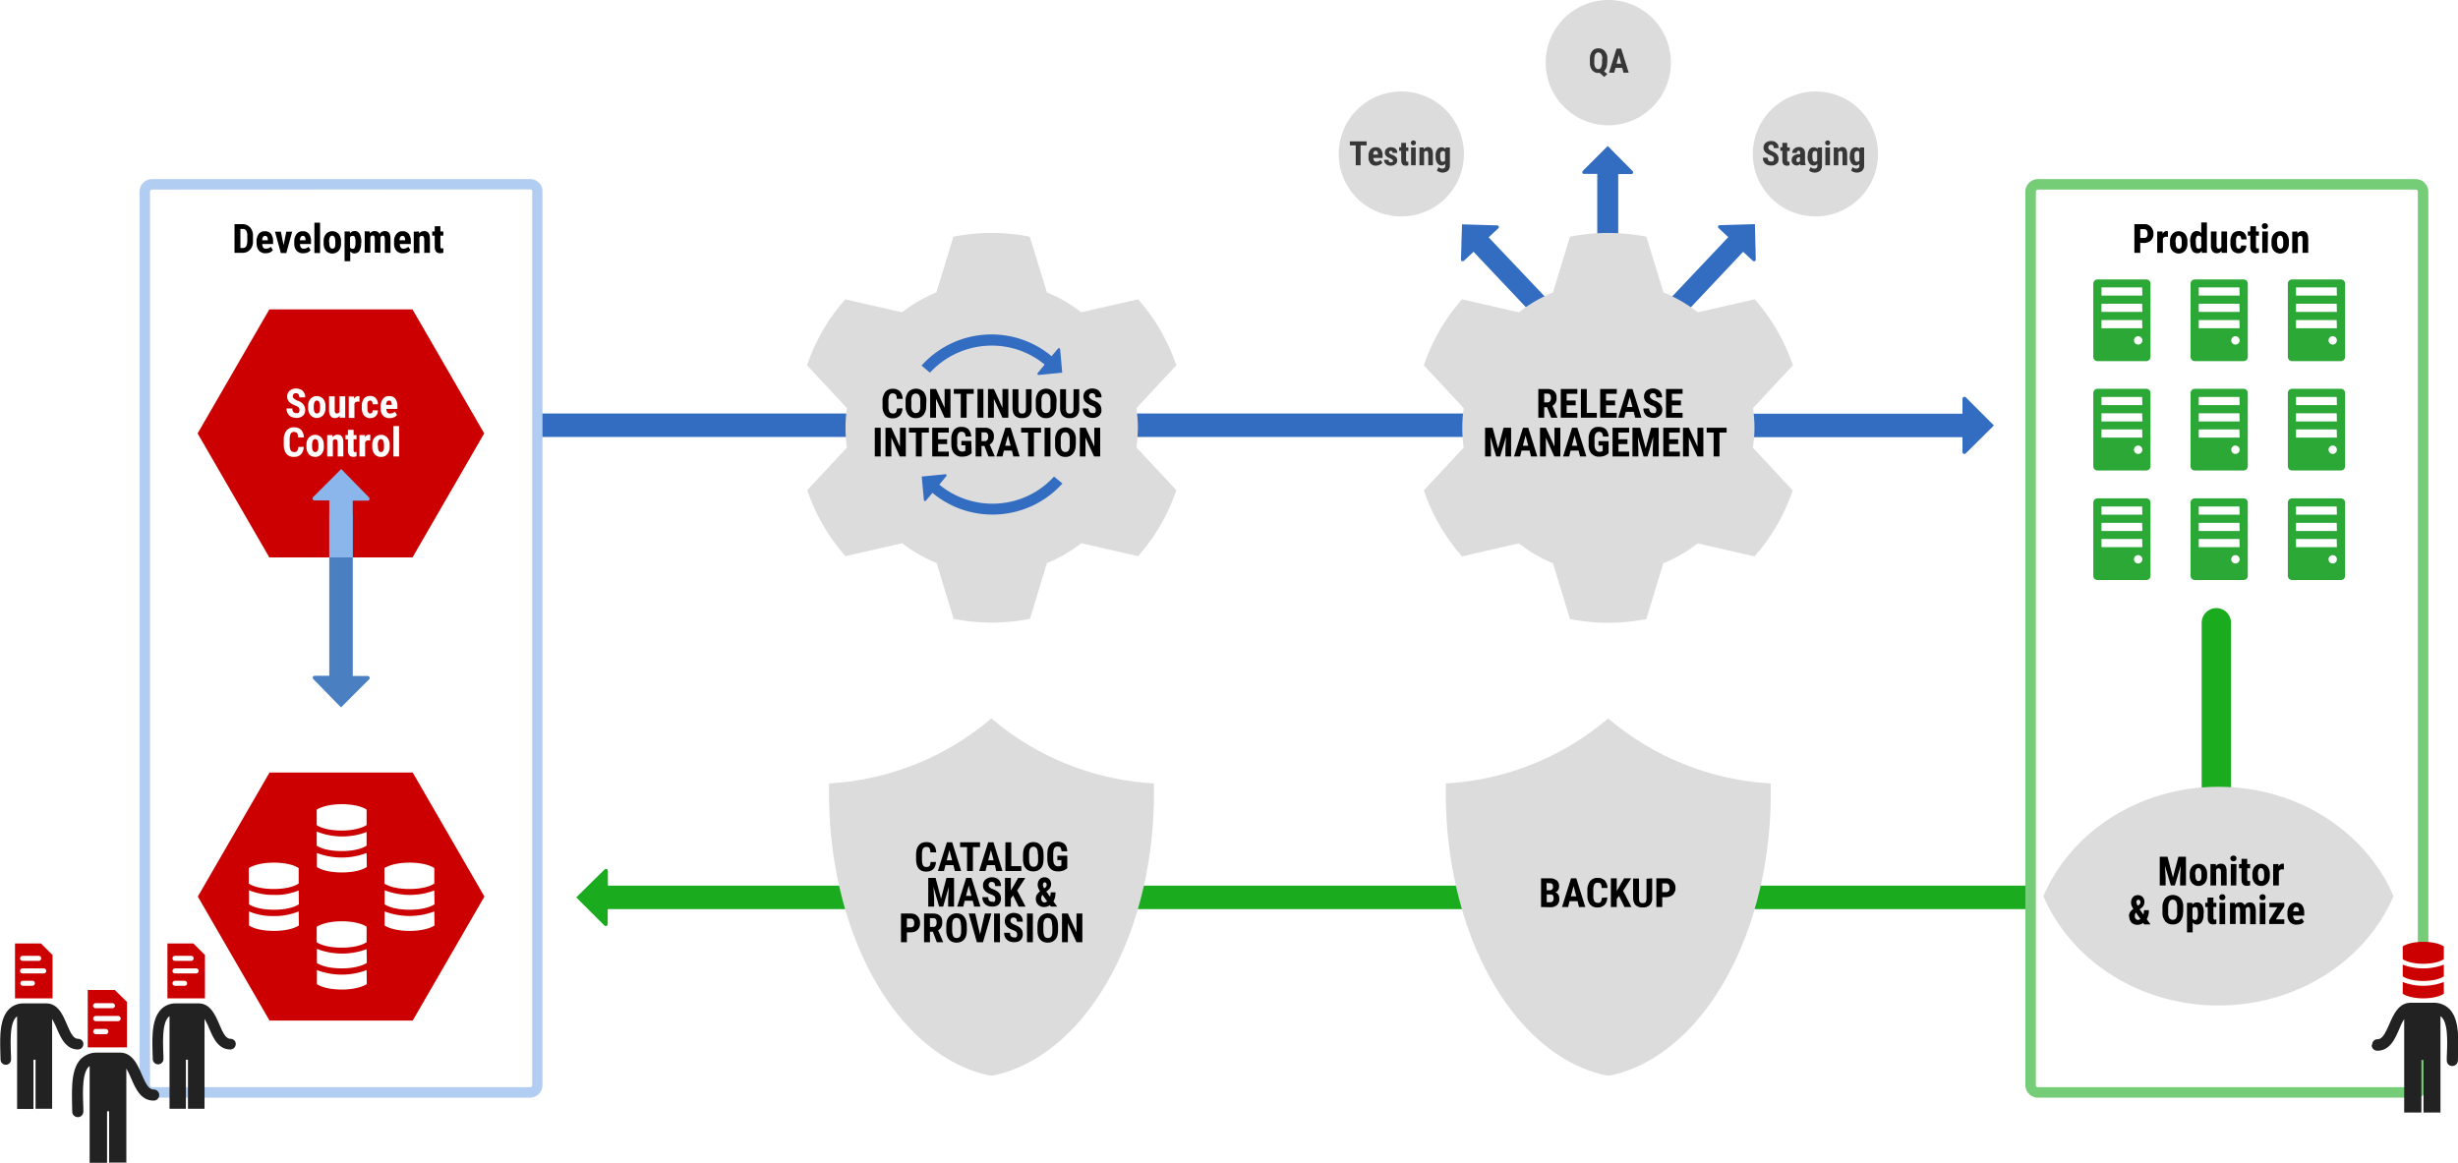
What does Compliant Database DevOps look like?
Standardize team-based development
Adopt the industry-standard tools for coding, comparison, and version control, to speed up and simplify team-based database development.

Slide 35
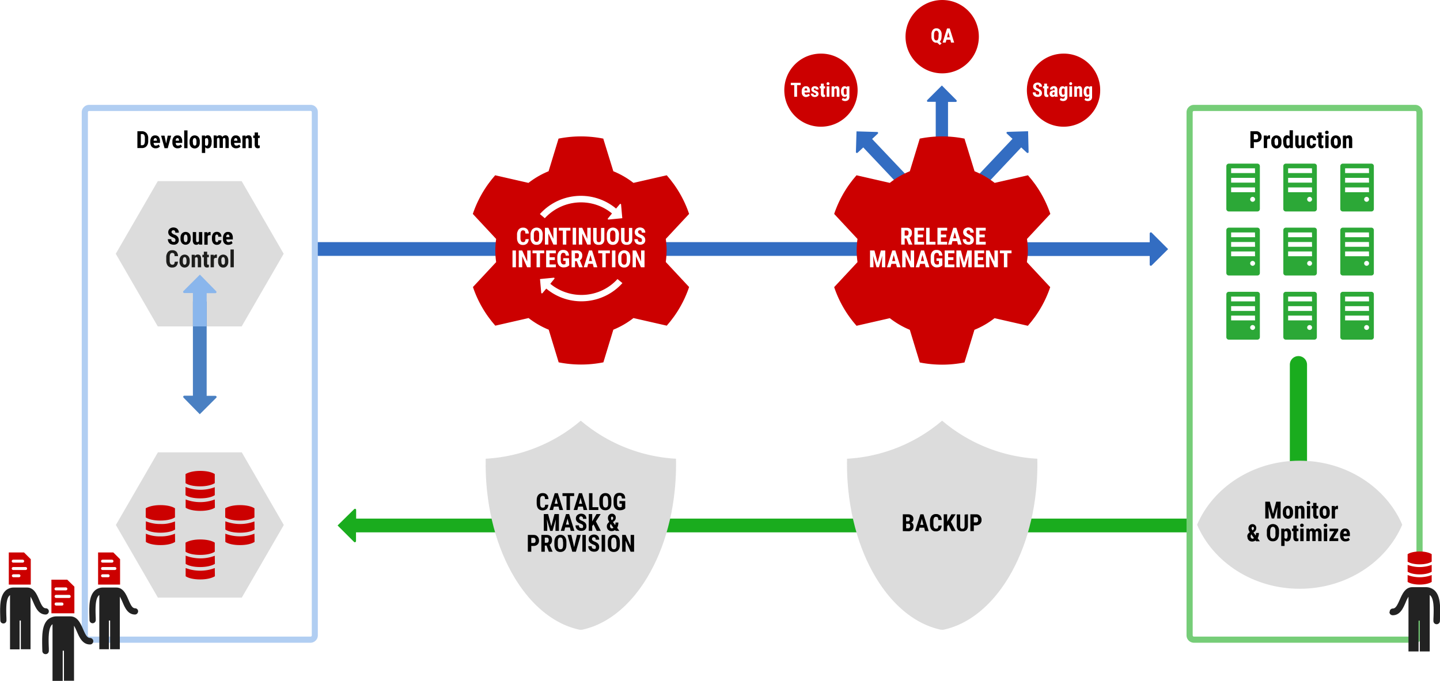
What does Compliant Database DevOps look like?
Automate database deployments
Implement a consistent, scalable, and repeatable process to automate database deployments.

Slide 36
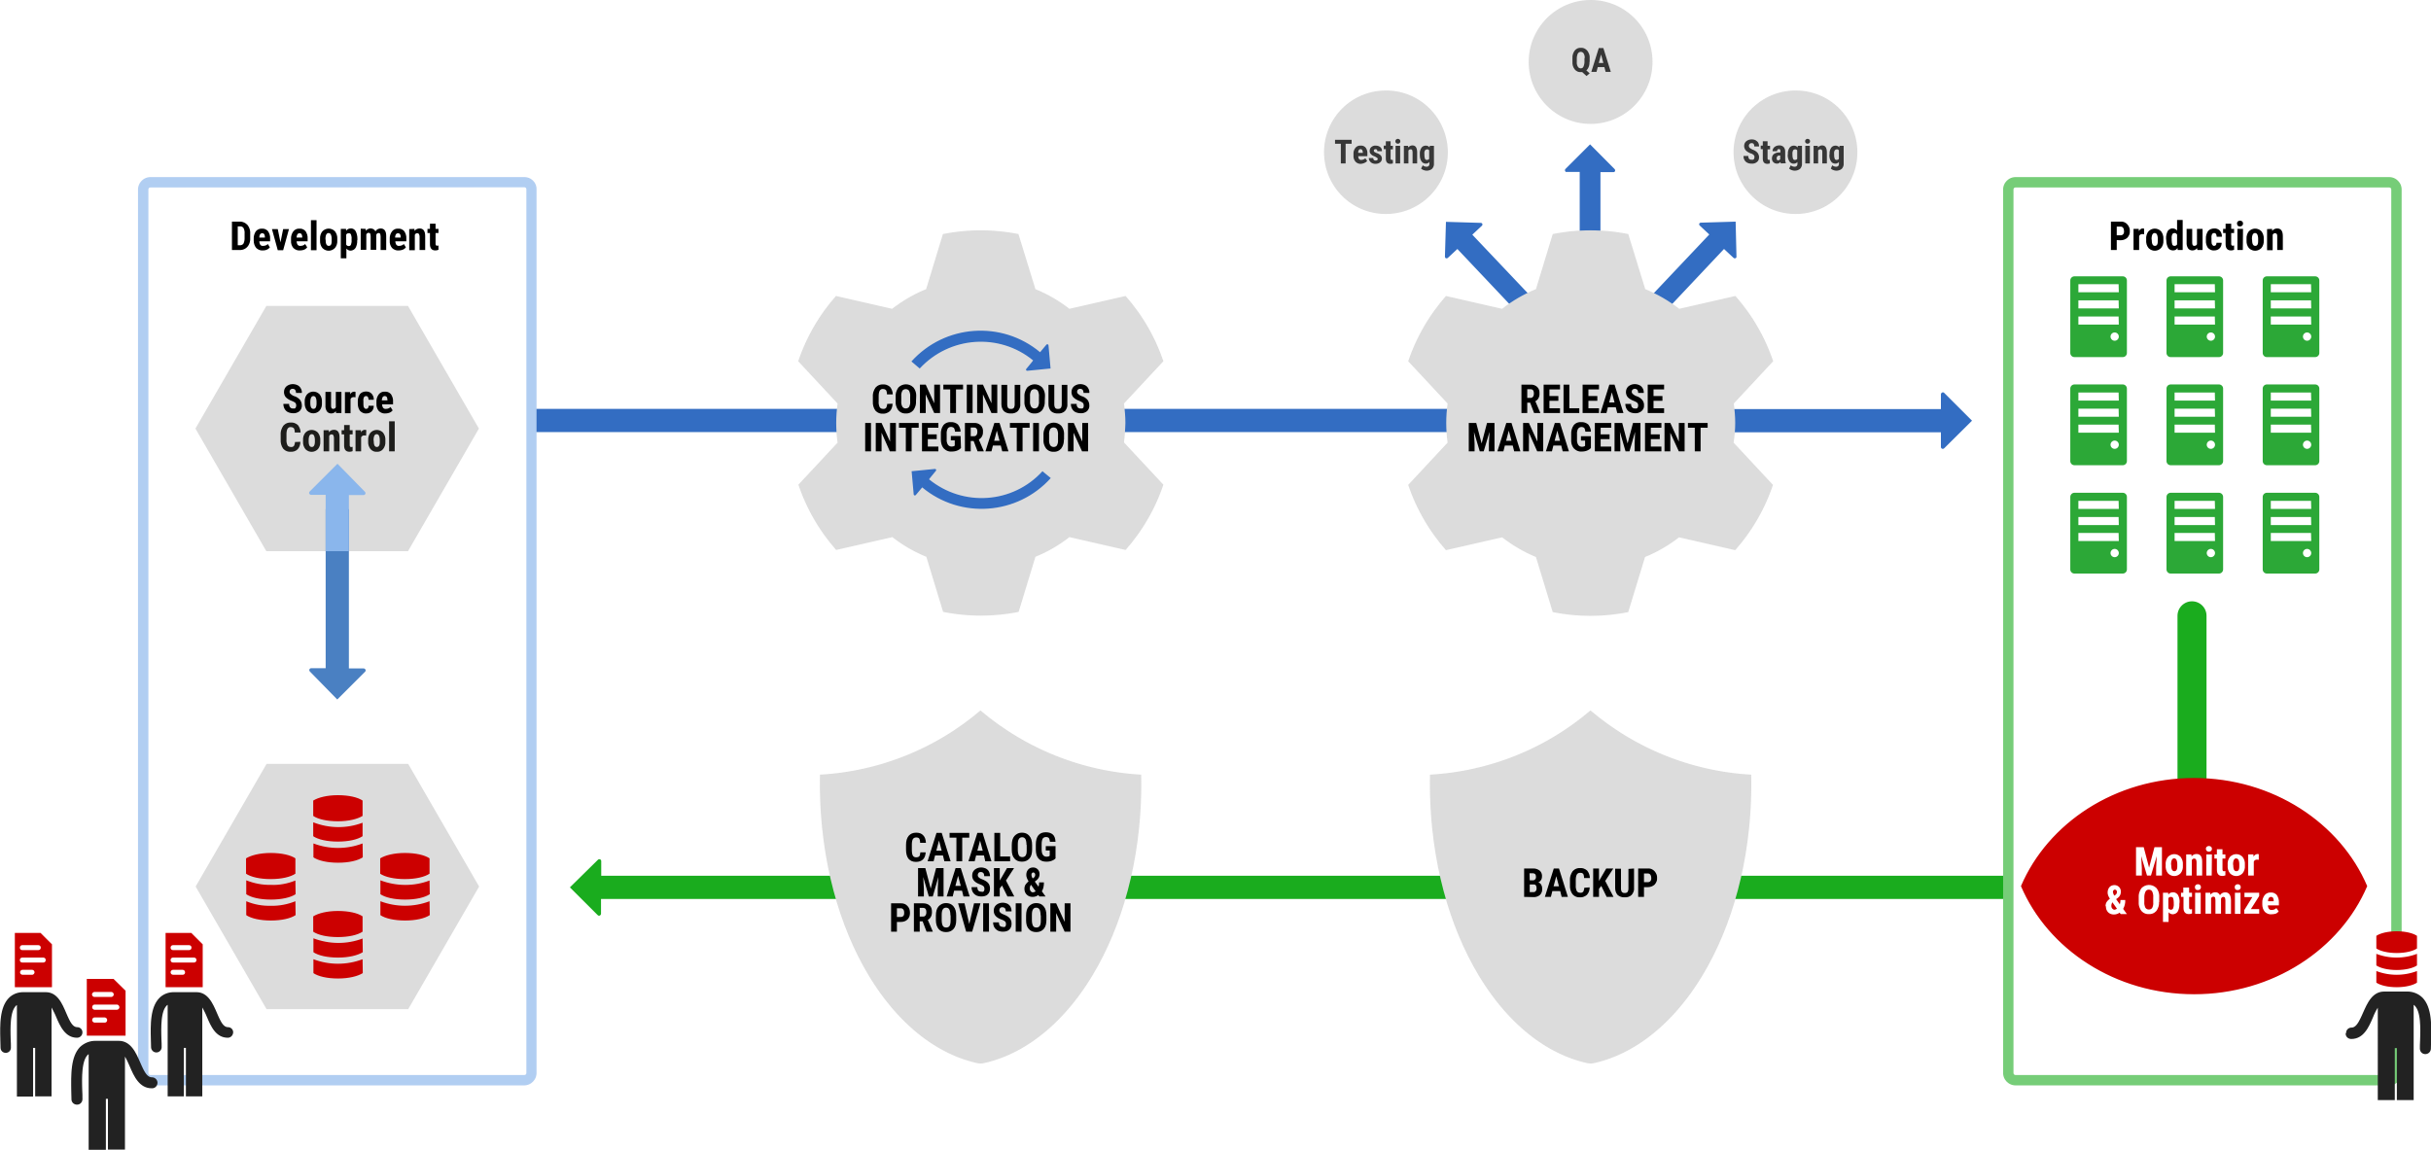
What does Compliant Database DevOps look like?
Monitor performance & availability
Continuously optimize your processes by diagnosing and resolving causes of operational and performance issues, including deployments.

Slide 37
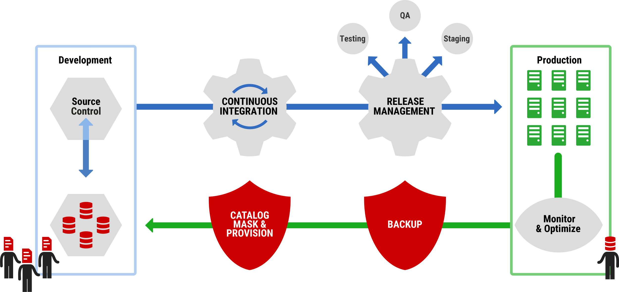
What does Compliant Database DevOps look like?
Protect and preserve data
Protect sensitive data as it moves through database environments.

Slide 38
Compliant Database DevOps
Standardize
team-based development
Automate
database deployments
Monitor
performance & availability
Protect
and preserve data

Slide 39
Tables and Charts

Slide 40
Tool | Existing licenses | Total needed | Shortfall
SQL Toolbelt | 81 | 170 | 89
SQL Monitor (provision) | 154 | 514 | 360
SQL Monitor (non-production) | 0 | 214 | 214
Deployment Suite for Oracle | 0 | 5 | 5
SQL Provision | 20 | 30 | 10TB
Notes:
Example of a table formatted with RG colours and font

Slide 41
Notes:
Column

Slide 42
Notes:
Column

Slide 43
Notes:
Pie

Slide 44
Notes:
Line

Slide 45
Notes:
2D bar

